Slide 1
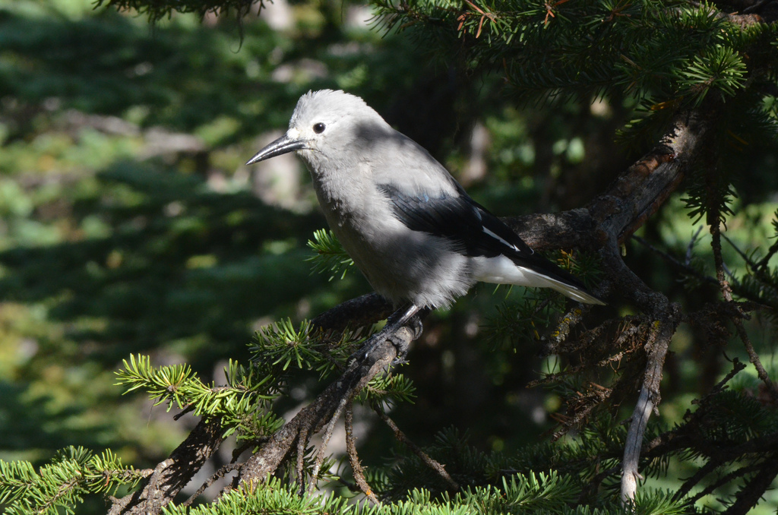
Connectivism, Online Learning, and the MOOC
Stephen Downes
June 15, 2013
WizIQ MOOC
Going Beyond the MOODLE MOOC for Active Lifelong Learning

Slide 2
Knowledge
Networks as Knowledge
Emergence
Distributed Representation
Association
Meaning
Personal v Public Knowledge

Slide 3
Learning
‘Downes Theory’ of Pedagogy
Personal Learning
Network-Based Assessment
Personal Learning Environments
Personal Learning

Slide 4
Community
Education and Democracy
Collaboration and Cooperation
Autonomy
Diversity
Openness
Interactivity

Slide 5

Knowledge

Slide 6
Three Kinds of Knowledge
Qualitative – properties, qualities, relations
Quantitative – number, mass, proportion
Connective – patterns, networks, causes, impacts

Slide 7
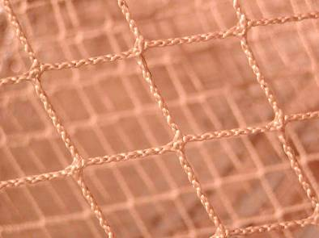
What ‘knowing’ is…
the knowledge is in the network
Old: universals
– rules
– categories
New: patterns
– similarities
– coherences
the knowledge is the network

Slide 8
Emergence
How we perceive patterns of connectivity
  Take the actual connections, and interpret them as a distinct whole
  Take the distinct whole, and interpret as a set of connections
As Hume would say, our 'perception' of a causal relationship between two events is more a matter of 'custom and habit' than it is of observation.

Slide 9
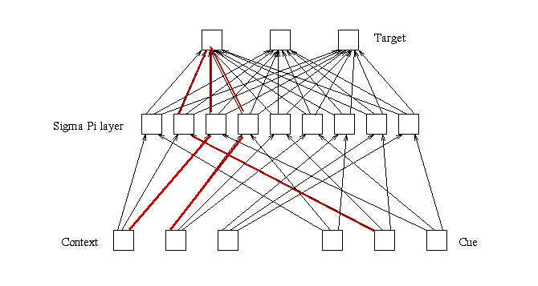

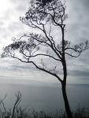
stands for?
Hopfield
Or is caused by?
Distributed Representation
= a pattern of connectivity

Slide 10
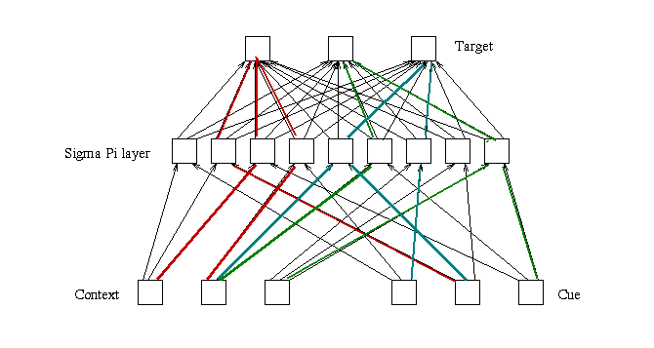
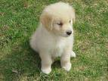


Slide 11
Meaning
Traditionalist theories – ‘meaning’ is the state of affairs represented or described
But what about ‘redness’, or ‘17’, or ‘power law?’
the concept of 'redness' in our own mind is similar to having 'liberal' as a description of a political party – it is composed of the organization of low-level non-meaningful entities

Slide 12
Organization
  Personal knowledge: The organization of neurons
  Public Knowledge: The organization of artifacts
A common underlying logic: graph theory, connectionism, social network theory, etc.
If a human mind can come to 'know', and if a human mind is, essentially, a network, then any network can come to 'know', and for that matter, so can a society.

Slide 13
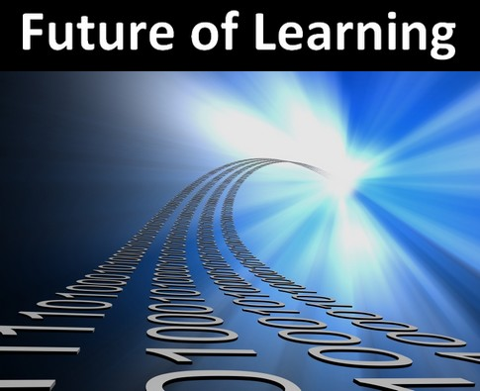
Learning

Slide 14
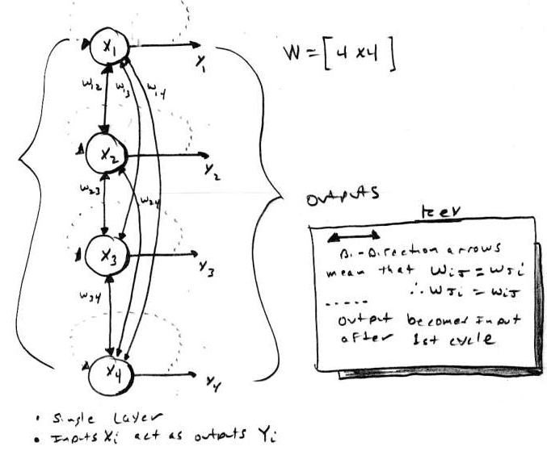

This…
Network Learning…
Hebbian associationism
  based on concurrency
Back propagation
  based on desired outcome
Boltzman
  based on ‘settling’, annealing

Slide 15
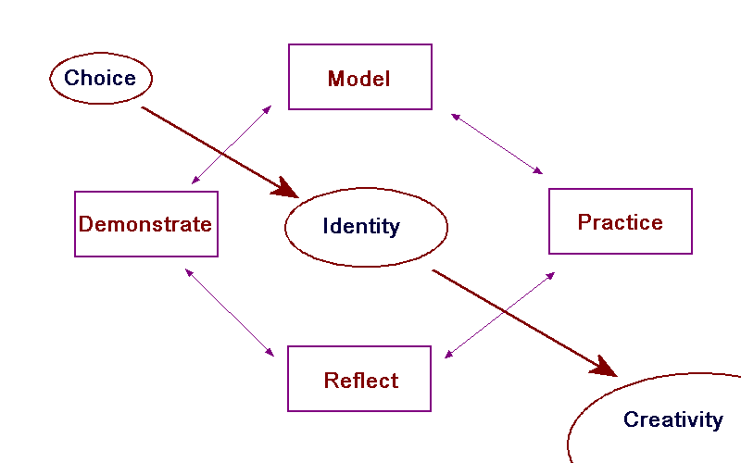
‘Downes Theory’ of Pedagogy

Slide 16
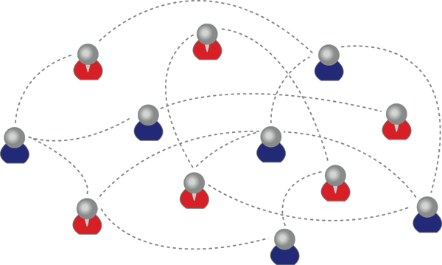
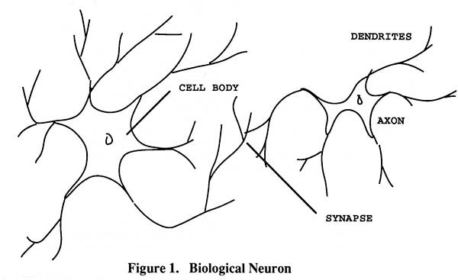
Personal Learning
We are using one of these
To create one of these

Slide 17
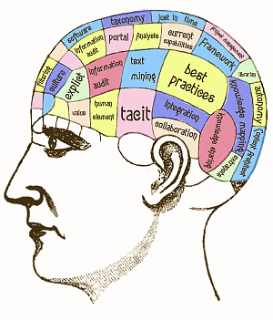
Developing personal knowledge is more like exercising than like inputting, absorbing or remembering

Slide 18
Network-Based Assessment
We recognize this
By perfomance in this

Slide 19
Personal Learning Environment
A PLE is a tool intended to immerse yourself into the workings of a community

Slide 20
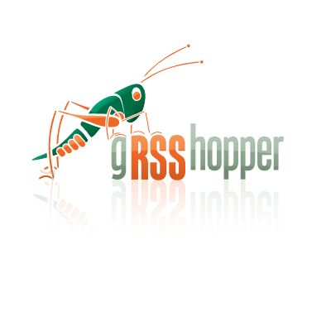
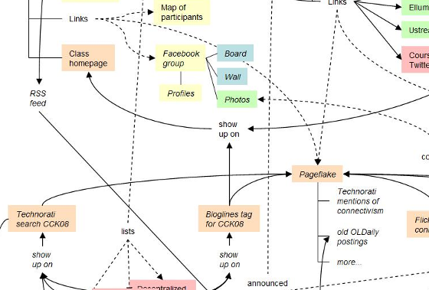
gRSShopper
A tool for managing connections
Used in Connectivism course

Slide 21
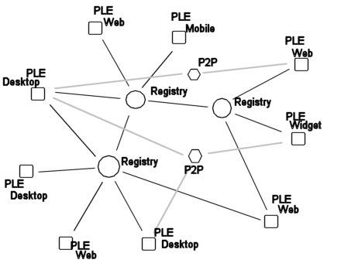
PLEs in a Network
PLEs are envisioned as working as a network

Slide 22
Personal Professional Development
Most important to manage your own professional development
The phrase in English is “eat your own dog food” – use the practices to teach yourself
Form, create, and work with networks of other professionals
Downes on Personal Professional Development
http://www.downes.ca/presentation/217

Slide 23

Community

Slide 24
Education and Democracy
Education is not about remembering a body of predefined content
It is about the citizens communicating what they know with each other
If follows that OERs are necessary for this democratic vision of education
The owners of education are the citizens of a society, not the governments and corporations
Papert and Freire on the Future of School
http://www.papert.org/articles/freire/freirePart1.html

Slide 25
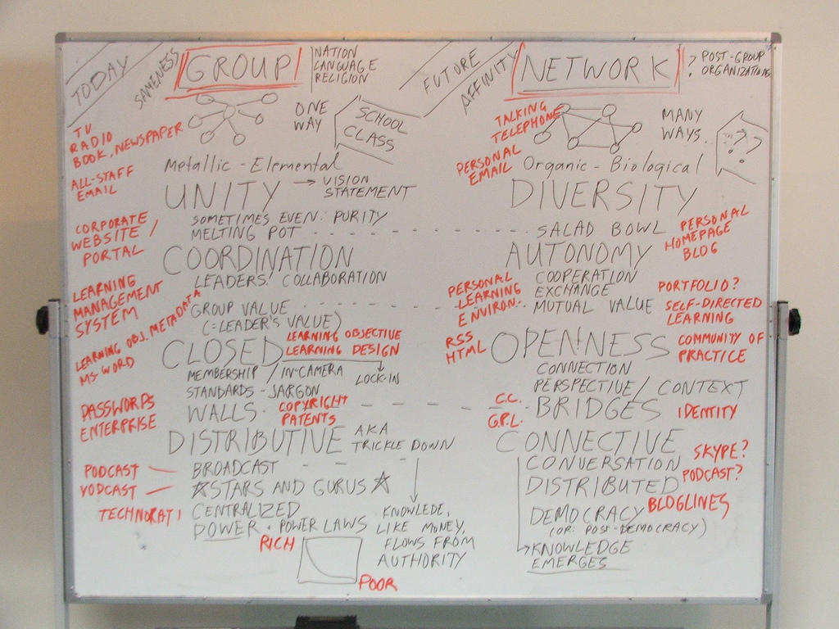
Elements of Cooperation
COLLABORATION
COOPERATION

Slide 26
Principles of Effective Design (2)
Semantic (intentional) principles:
  Autonomy
  Diversity
  Openness
  Interactivity

Slide 27
Autonomy
Factors affecting mental states
  Empirical, cognitive, psychological
Capacity to act on mental states
  Physical, social, structural, resources
Scope and range of autonomous behaviour
  Expression, association, selection, method…
Effects of autonomous behaviour
  Impact, improvement
http://halfanhour.blogspot.com/2010/11/model-of-autonomy.html

Slide 28
Diversity
Composition
  Many types of entities
Intention
  Different goals, desires (Mill)
Perspective
  Uniqueness of point of view, language
Mathematics of diversity
  Multiple inputs produce mesh networks
http://lemire.me/fr/abstracts/DIVERSITY2008.html
http://www.huffingtonpost.com/stephen-downes/democratizing-education_b_794925.html

Slide 29
Diversity (2)
Putnam, Florida, and the rest of it
Homophily and associationism
Teaching what we have in common instead of our differences? No
http://www.downes.ca/post/53544
http://profesorbaker.wordpress.com/2011/01/30/homophily-and-heterophily-what-fires-together-wires-together-cck11/
http://secondlanguagewriting.com/explorations/Archives/2007/August/TheDownsideofDiversity.html

Slide 30
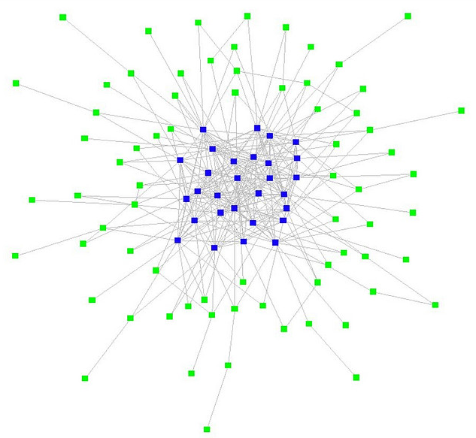
Openness
Open education
  Open content, teaching, assessment
  Stages of openness and terminal path
Open networks
  Clustering instead of grouping
Flow
  Input, output, feedback
  plasticity
http://www.flickr.com/photos/ross/2916958593/

Slide 31
The Importance of Open Educational Resources
Enables people to pursue their own personal interests in their own way
But, more importantly, OERs become the medium of communication
We need to view OERs, not as resources created by publishers at great cost, but as created by learners to interact with each other
The role of professionals and publishers becomes the production of ‘seed OERs’

Slide 32
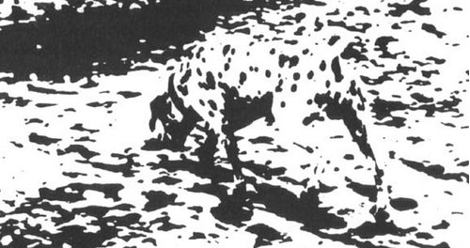
Interactivity
Influence vs emergence
  Thought-bubbles – “we perceive wholes where there are only holes”
‘Scope’ vs ‘Level’
  http://www.downes.ca/post/42066
Ontology of emergence
  Ontological (real) vs perceptual (recognized)
Connection to complexity & chaos
http://www.downes.ca/post/55001
http://connect.downes.ca/post/44222

Slide 33
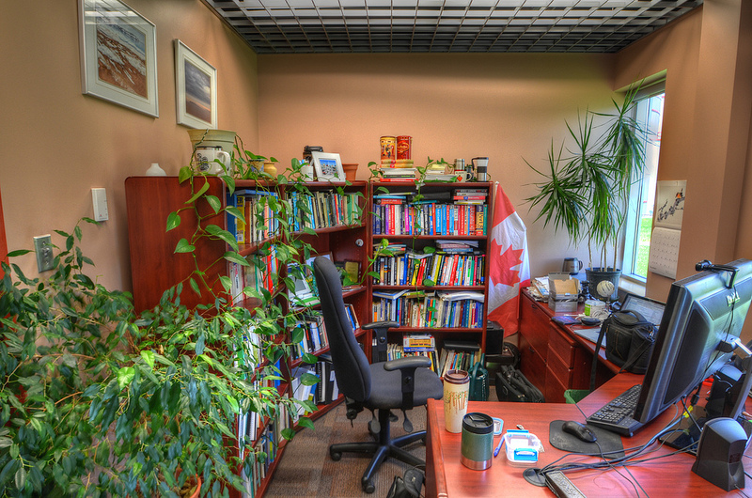
Stephen Downes
http://www.downes.ca

